Slide 1

Cloud Native Applications: What Changed?
February 2013
Adrian Cockcroft
@adrianco #netflixcloud @NetflixOSS
http://www.linkedin.com/in/adriancockcroft

Slide 2
Cloud Native?
Agile Infrastructure
NetflixOSS – Cloud Native On-Ramp

Slide 3
February 8th, 2005

Slide 4
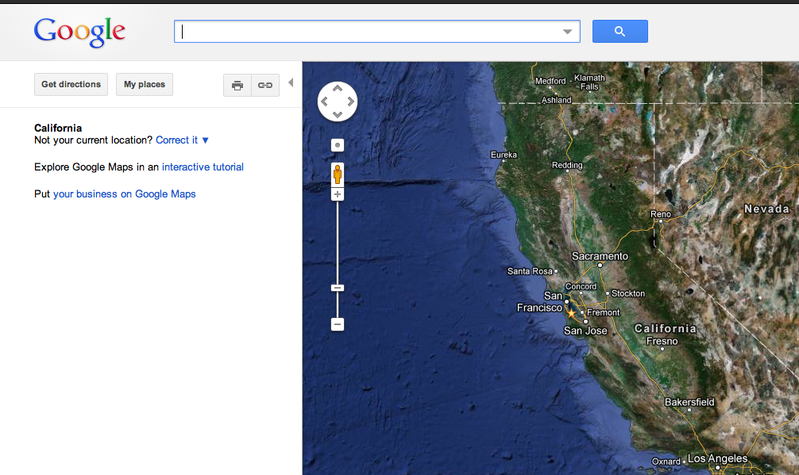
Google Maps Launched

Slide 5
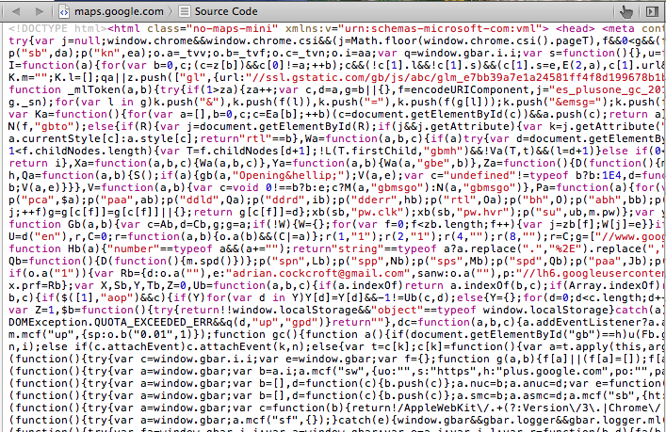
View Source

Slide 6
Web 2.0 Had Arrived…
Static HTML -> JavaScript

Slide 7
Web Native Applications
Running in the browser

Slide 8
Code Visible to Everyone
Techniques spread rapidly

Slide 9
Totally new development patterns and tools
(Slow enterprise adoption)

Slide 10
August 25th, 2006

Slide 11
AWS EC2 Launched
Infrastructure as a Service

Slide 12
Forklift Old Code to the Cloud
Faster than datacenter deployments but fragile

Slide 13
New Anti-Fragile Patterns
Micro-services
Chaos engines
HA systems composed from ephemeral components

Slide 14
Open Source Platforms
Techniques spread rapidly

Slide 15
Totally new development patterns and tools
(Slow enterprise adoption)

Slide 16
Hybrid Cloud Architecture
iOS/Android
App Server
MySQL
Cloud
Datacenter
Mobile
Legacy Apps

Slide 17
Cloud Native Architecture
Things
JVM
Cassandra
Cassandra
Autoscaled Micro Services
Distributed NoSQL Datastores
Clients
Cassandra
JVM
JVM
JVM
Autoscaled Micro Services
JVM
Memcached

Slide 18
Cloud Native
Master copies of data are cloud resident
Everything is dynamically provisioned
All services are ephemeral

Slide 19
Scale
Public vs. Private Clouds
Rate of change matters
How big is too big?

Slide 20
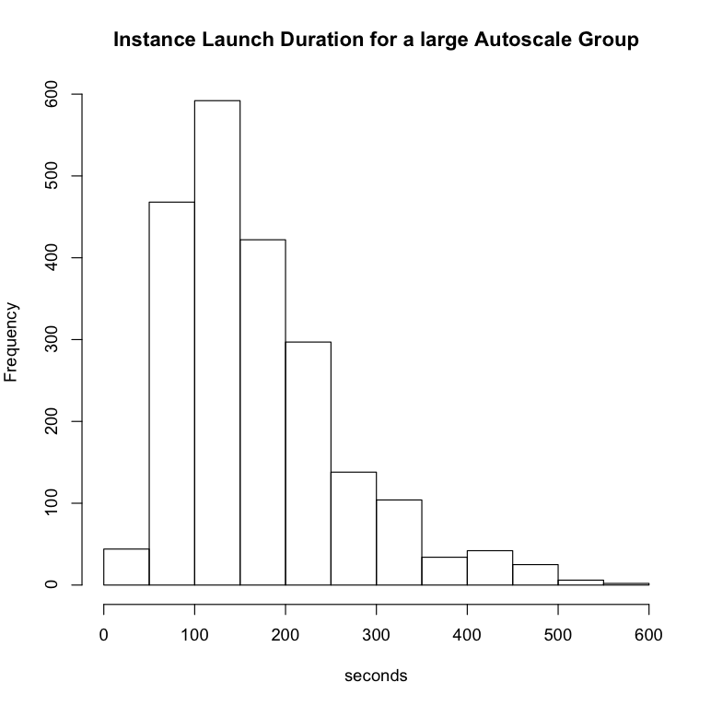
Cloud Deployment Scalability
New Autoscaled AMI – zero to 500 instances from 21:38:52 - 21:46:32, 7m40s
Scaled up and down over a few days, total 2176 instance launches, m2.2xlarge (4 core 34GB)
Min. 1st Qu. Median Mean 3rd Qu. Max.
41.0 104.2 149.0 171.8 215.8 562.0

Slide 21
Leveraging Public Scale
Public
Grey Area
Private
1,000 Instances
100,000 Instances
Startups
Netflix
Google

Slide 22
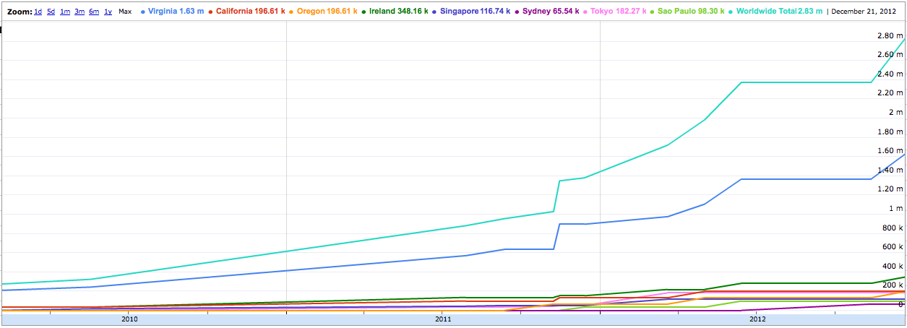
Size and Growth Rate
AWS Maximum Instance Count Growth
~9x in Three Years, ~300% Per Annum
AWS upper bound estimate based on the number of public IP Addresses

Slide 23
Availability
Is it running yet?
How many places is it running in?
How far apart are those places?

Slide 24
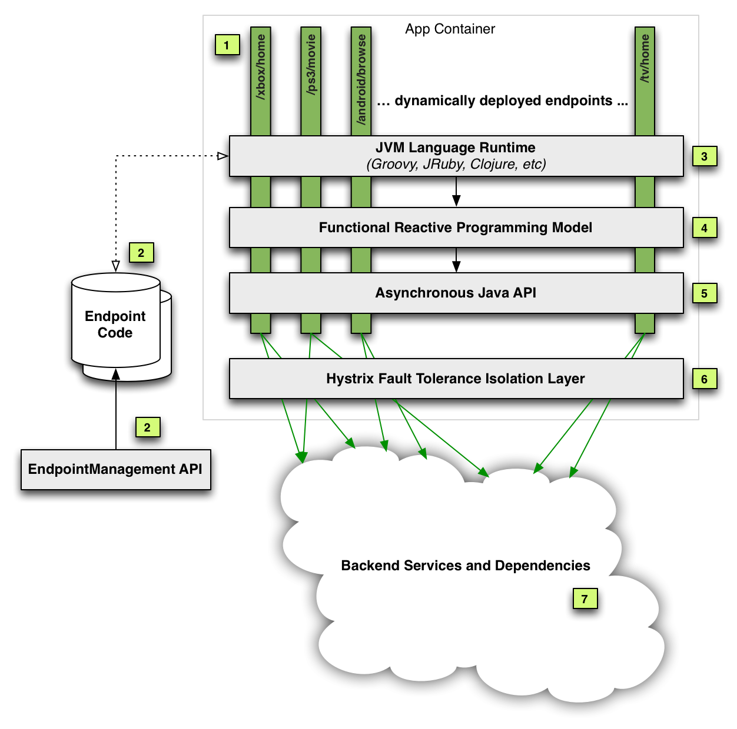
Antifragile Development Patterns Functional Reactive with Circuit Breakers and Bulkheads

Slide 25


Slide 26
Managing Multi-Region Availability
AWS Route53
DynECT DNS
UltraDNS
Zone A
Cassandra Replicas
Zone B
Cassandra Replicas
Zone C
Cassandra Replicas
Regional Load Balancers
Regional Load Balancers
Zone A
Cassandra Replicas
Zone B
Cassandra Replicas
Zone C
Cassandra Replicas
What we need is a portable way to manage multiple DNS providers….

Slide 27
Denominator Software Defined DNS
Denominator
AWS Route53
DynECT
Common Model
DNS Vendor Plug-in
UltraDNS
Etc…
Edda, Multi-Region Failover
Use Cases
API Models (varied and mostly broken)
IAM Key Auth REST
User/pwd REST
User/pwd SOAP
Currently being built by Adrian Cole (the jClouds guy, he works for Netflix now…)

Slide 28
Capacity
Interesting apps are unpredictable
Just in time provisioning
Give it back

Slide 29
Capacity Profiles

Slide 30
Cloud Costs
Unpredictable?
Post-optimized reservations
Capitalize the base load

Slide 31
Configuration Management
Datacenter CMDB’s woeful
Cloud is a model driven architecture
Dependably complete

Slide 32
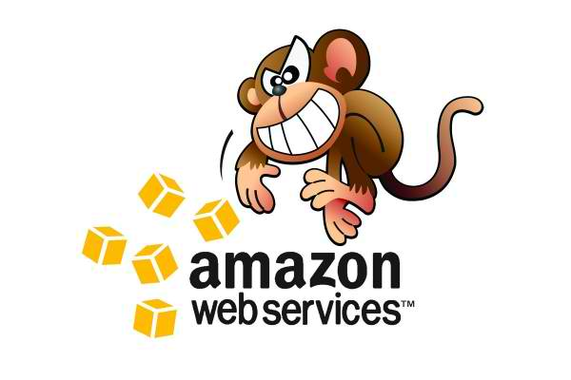
Edda – Configuration History http://techblog.netflix.com/2012/11/edda-learn-stories-of-your-cloud.html
Edda
AWS Instances, ASGs, etc.
Eureka Services metadata
AppDynamics Request flow
Monkeys

Slide 33
Edda Query Examples
Find any instances that have ever had a specific public IP address
$ curl "http://edda/api/v2/view/instances;publicIpAddress=1.2.3.4;_since=0"
["i-0123456789","i-012345678a","i-012345678b”]
Show the most recent change to a security group
$ curl "http://edda/api/v2/aws/securityGroups/sg-0123456789;_diff;_all;_limit=2"
--- /api/v2/aws.securityGroups/sg-0123456789;_pp;_at=1351040779810
+++ /api/v2/aws.securityGroups/sg-0123456789;_pp;_at=1351044093504
@@ -1,33 +1,33 @@
{
…
"ipRanges" : [
"10.10.1.1/32",
"10.10.1.2/32",
+ "10.10.1.3/32",
- "10.10.1.4/32"
…
}

Slide 34
Security
Security baked into patterns
Strong assertions
Iterate over infrastructure

Slide 35
Impossible Things
Reducing friction
Speeding up the OODA cycle
Rapid innovation

Slide 36
Product Lifecycle
Idea
Concept
Development
Experimentation
Operation
Scaling
Retirement
Shut down
Testing
Optimization
Hypothesis
Archive
OODA Loop for Testable Ideas
Cloud - Each step takes minutes
Datacenter – Weeks or months

Slide 37
Real Example – Proxy in Brazil
AWS Brazil makes this trivial
Test didn’t show a big benefit
Shut it down and try something else
Idea
Front end in BR
Development
Reconfigure proxy
Operation
Deploy in 2 zones
Retirement
Shut down
Test traffic in BR
Scale to traffic
Latency reduction
Archive data
OODA Loop for Testable Ideas
Cloud - Each step takes minutes
Datacenter – Weeks or months

Slide 38
Scalability from 48 to 288 nodes on AWS http://techblog.netflix.com/2011/11/benchmarking-cassandra-scalability-on.html
2012 Production Data
Used 288 of m1.xlarge
4 CPU, 15 GB RAM, 8 ECU
Cassandra 0.86
Benchmark config only existed for about 1hr

Slide 39

A Cloud Native Open Source Platform

Slide 40
Three Questions
Why is Netflix doing this?
How does it all fit together?
What is coming next?

Slide 41
Platform Evolution
Bleeding Edge Innovation
Common Pattern
Shared Pattern
2009-2010
2011-2012
2013-2014
Netflix ended up several years ahead of the industry, but it’s not a sustainable position
Notes:
When Netflix first moved to cloud it was bleeding edge innovation, we figured stuff out and made stuff up from first principles. Over the last two years more large companies have moved to cloud, and the principles, practices and patterns have become better understood and adopted. At this point there is intense interest in how Netflix runs in the cloud, and several forward looking organizations adopting our architectures and starting to use some of the code we have shared. Over the coming years, we want to make it easier for people to share the patterns we use.

Slide 42
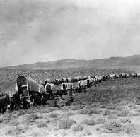
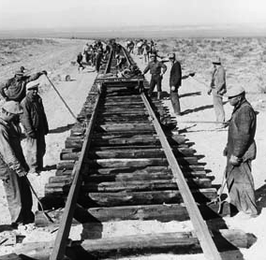

Making it easy to follow
Exploring the wild west each time
vs. laying down a shared route
Notes:
The railroad made it possible for California to be developed quickly, by creating an easy to follow path we can create a much bigger ecosystem around the Netflix platform

Slide 43
Goals
Build up Netflix Technology Brand
Hire, Retain and Engage Top Engineers
Establish our solutions as Best Practices / Standards
Benefit from a shared ecosystem

Slide 44

How does it all fit together?

Slide 45
NetflixOSS Continuous Build and Deployment
Github
NetflixOSS
Source
Maven
Central
AWS
Base AMI
Jenkins
Bakery
Dynaslave
AWS Build Slaves
AWS
Baked AMIs
Odin
Orchestration
API
Asgard
(+ Frigga)
Console
AWS Account

Slide 46
NetflixOSS Services Scope
AWS Account
Asgard Console
Multiple AWS Regions
Eureka Registry
Exhibitor ZK
3 AWS Zones
Evcache
Memcached
Ephemeral Storage
Cross region Priam C*
Edda History
Simian Army
Archaius Config Service
Explorers Dashboards
Atlas
Monitoring
Application Clusters
Autoscale Groups
Instances
Priam
Cassandra
Persistent Storage
Genie Hadoop Services

Slide 47
NetflixOSS Instance Libraries
Service Requests
Hystrix/Turbine – dependencies and real-time status
Ribbon - REST Client for outbound calls
Logging
Blitz4j – non-blocking logging
Initialization
Governator – Guice based dependency injection
Archaius – dynamic configuration properties client
Servo – metrics export for autoscaling
Karyon - Base Server for inbound requests
RxJava – Reactive pattern
Atlas – high volume instrumentation
Baked AMI – Tomcat, Apache, your code
Eureka - service registration client
Data Access
Astyanax – Cassandra client and pattern library
Evcache – Zone aware Memcached client
Curator – Zookeeper patterns
Denominator – DNS routing abstraction

Slide 48
NetflixOSS Testing and Automation
Test Tools
CassJmeter – load testing for C*
Availability
Chaos Monkey - Instances
Security
Security Monkey
Conformity Monkey
Latency Monkey – latency and error injection
Maintenance
Janitor Monkey
Efficiency Monkey
Chaos Gorilla – Availability Zones
Doctor Monkey
Circus Monkey – test rebalancing
Howler Monkey
Chaos Kong - Regions

Slide 49
More Features
What’s Coming Next?
Better portability
Higher availability
Easier to deploy
Contributions from end users
Contributions from vendors
More Use Cases

Slide 50

Functionality and scale now, portability coming
Moving from parts to a platform in 2013
Netflix is fostering an ecosystem
Rapid Evolution - Low MTBIAMSH
(Mean Time Between Idea And Making Stuff Happen)

Slide 51
Takeaway for Net Futures
Adopt Cloud Native patterns and take the friction out of innovation.
(and please don’t build broken APIs…)
http://netflix.github.com
http://techblog.netflix.com
http://slideshare.net/Netflix
http://www.linkedin.com/in/adriancockcroft
@adrianco #netflixcloud @NetflixOSS

